Slide 1
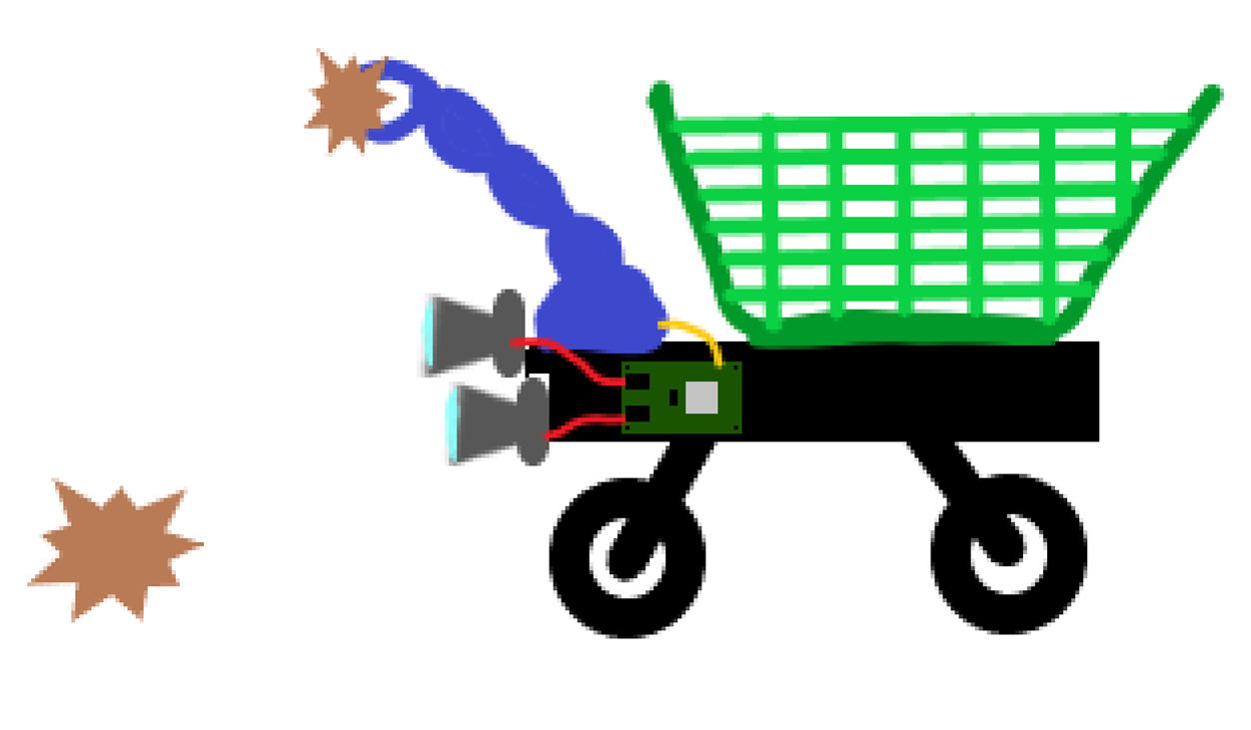
Stereo Visual Odometry
- Camera parameters
- Stereo matching and depth estimation
- Feature detection

Slide 2
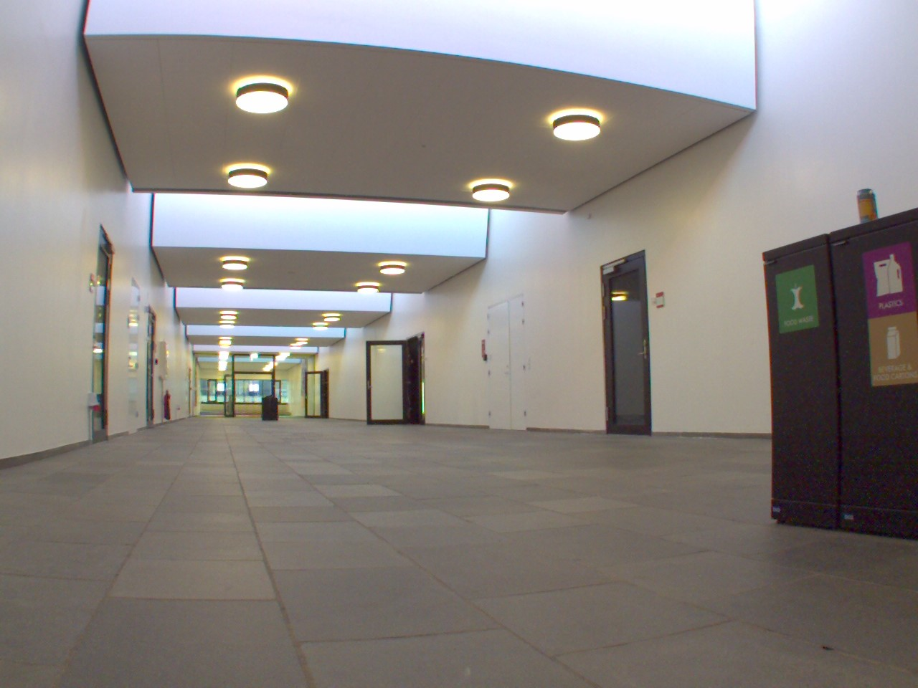
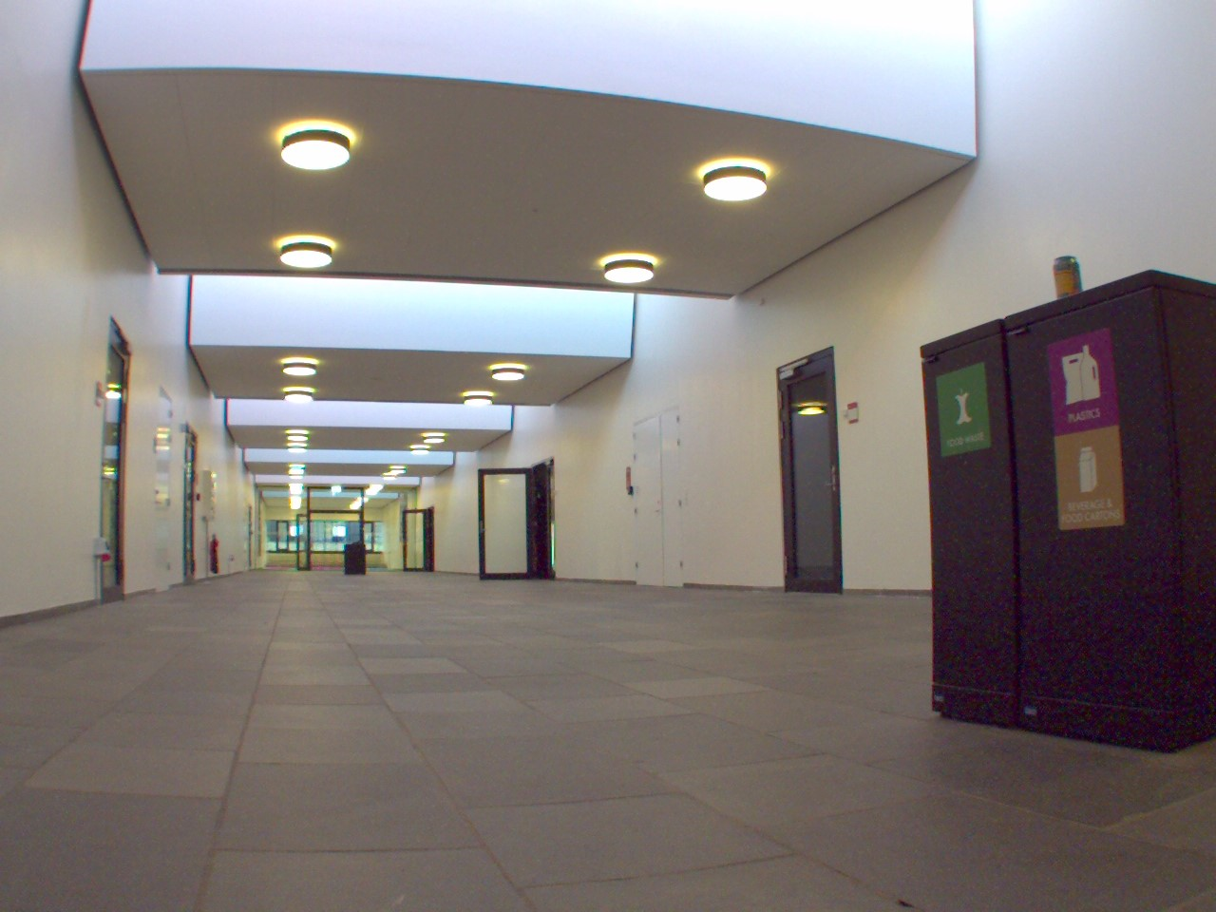
Adjusted camera parameters

Slide 3
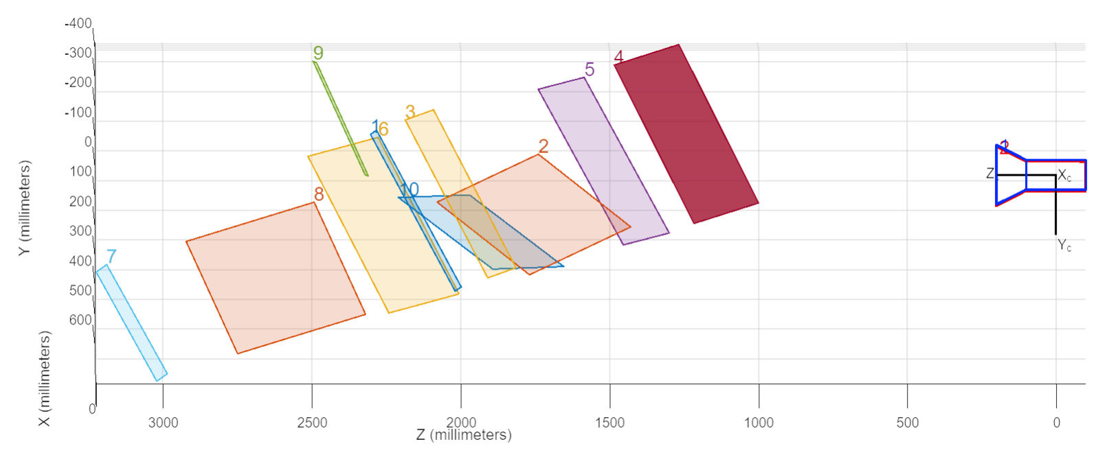
Ground truth

Slide 4
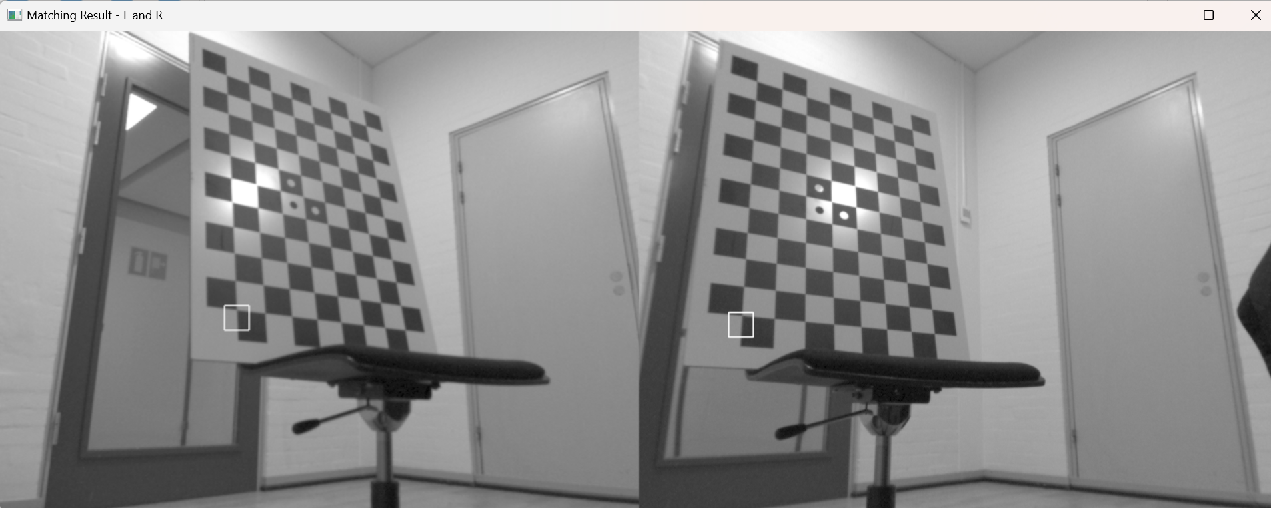
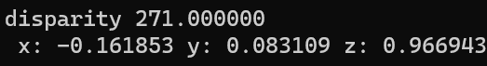
Result

Slide 5
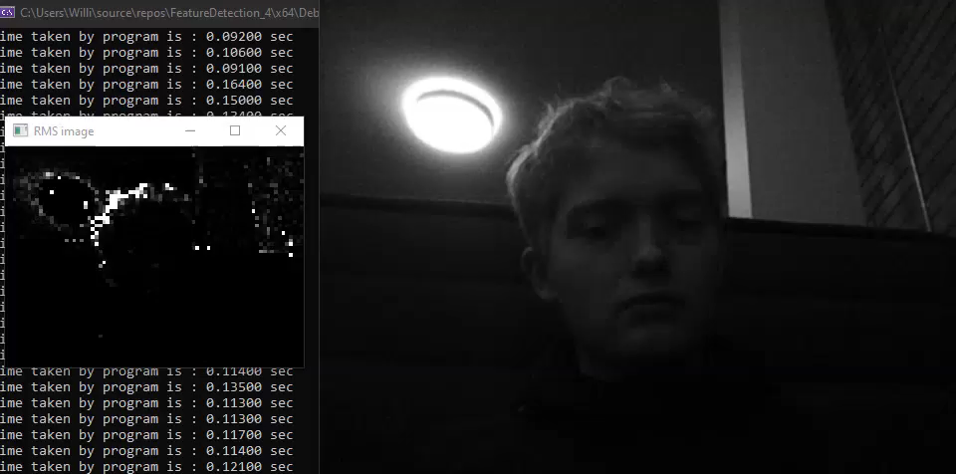
Harris Corner Detection

Slide 6
Feature Tracking

Slide 7
What to do now?
- Motion estimation
- Processsing time consideration
- Improve stereo matching > rectify only the point of interest

